Slide 1
MXLib2019Core Jenkins Config Guide
YD Chiang
2019/01/12

Slide 2
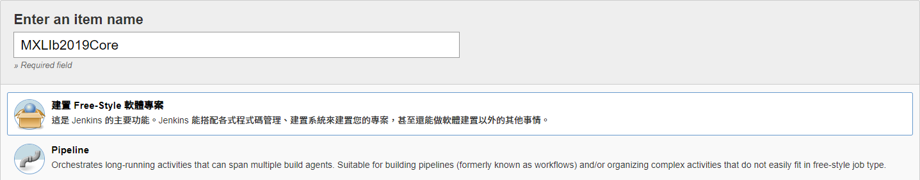
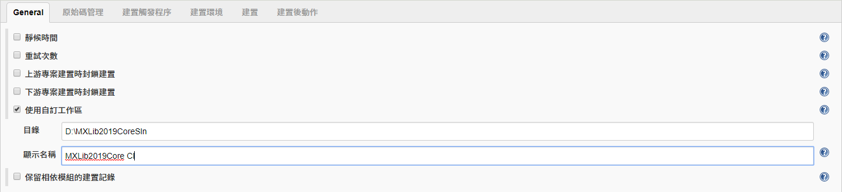
建立新Jenkins作業

Slide 3
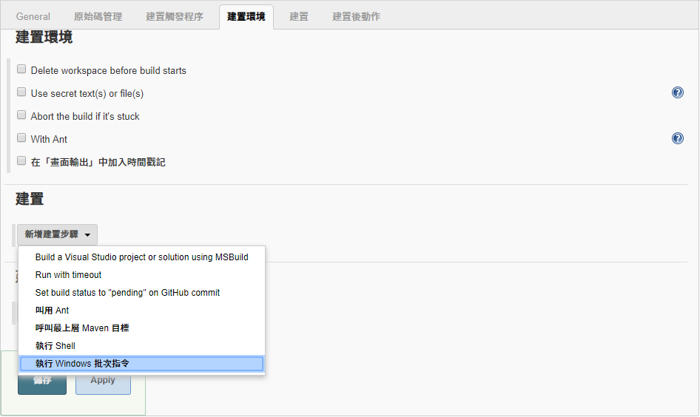
新增建置步驟

Slide 4
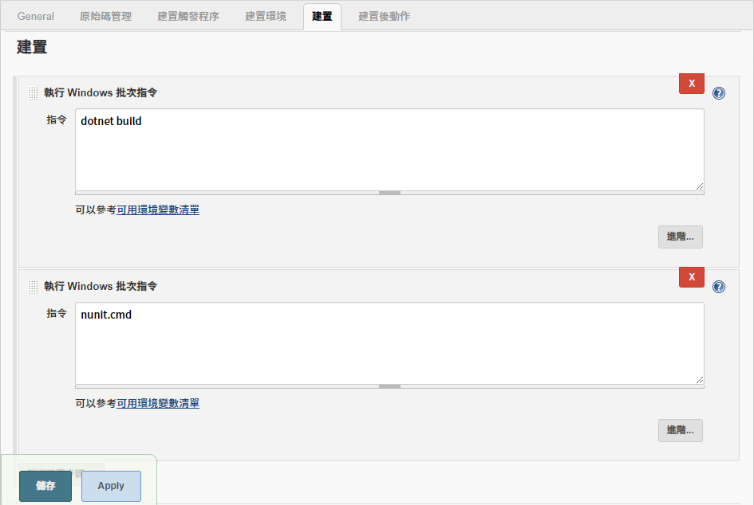
設定建置與執行寫好的NUnit指令

Slide 5
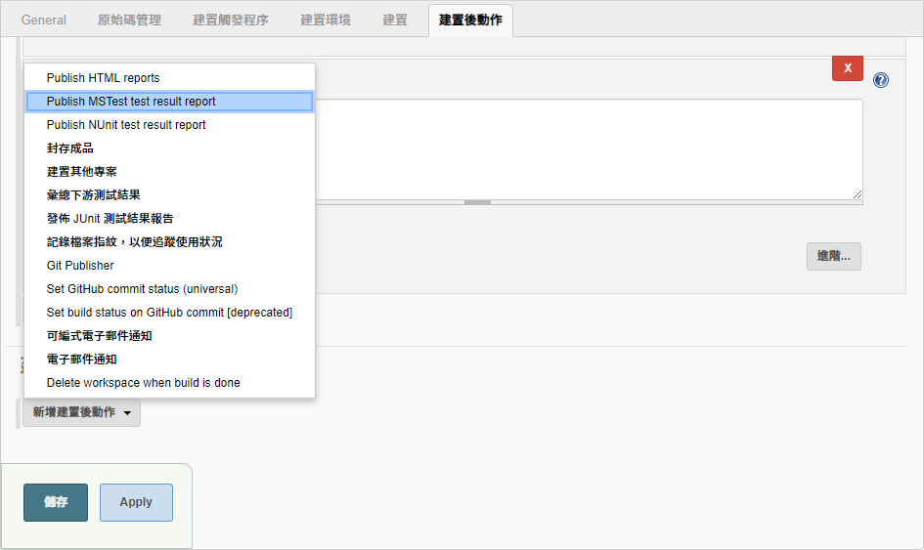
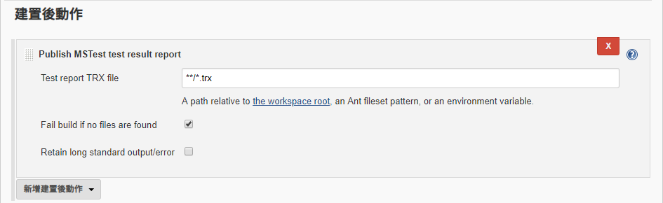
設定發佈Unit Test Result Report

Slide 6
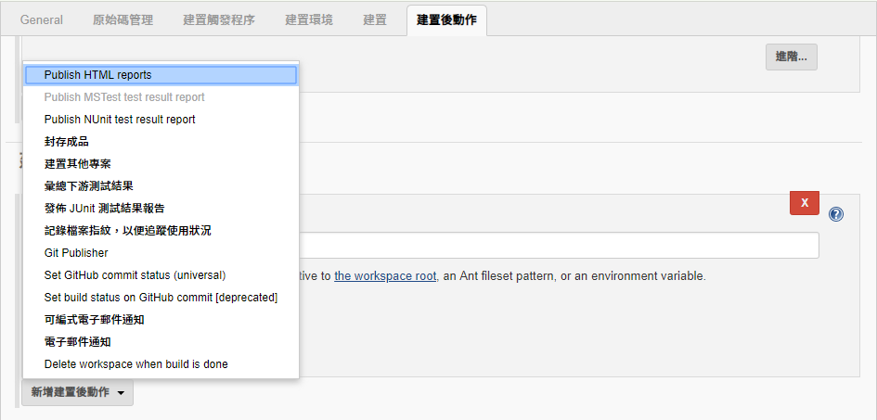
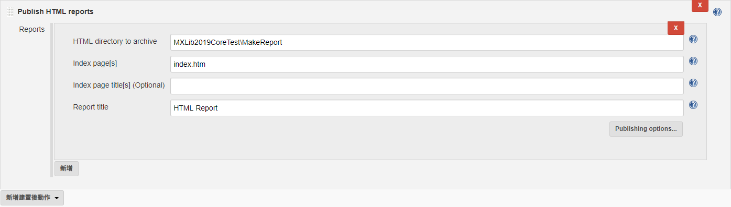
設定發佈Code Coverage Report

Slide 7
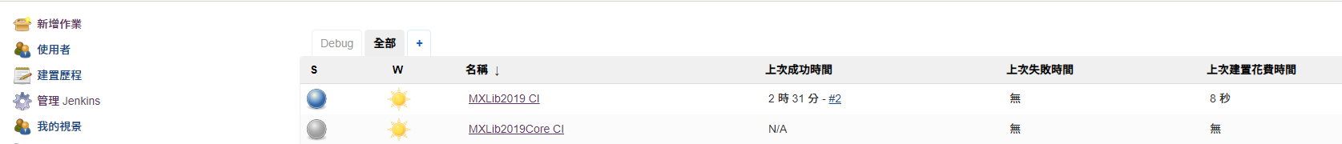
完成Jenkins作業設定

Slide 8
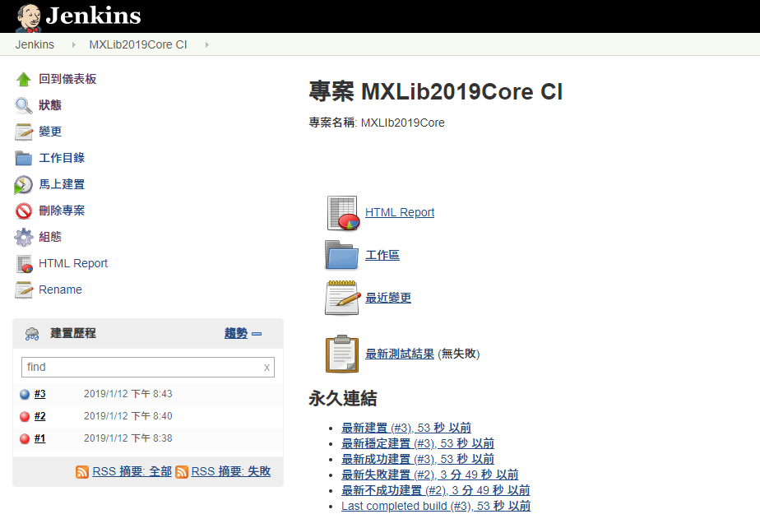
建置完成

Slide 9
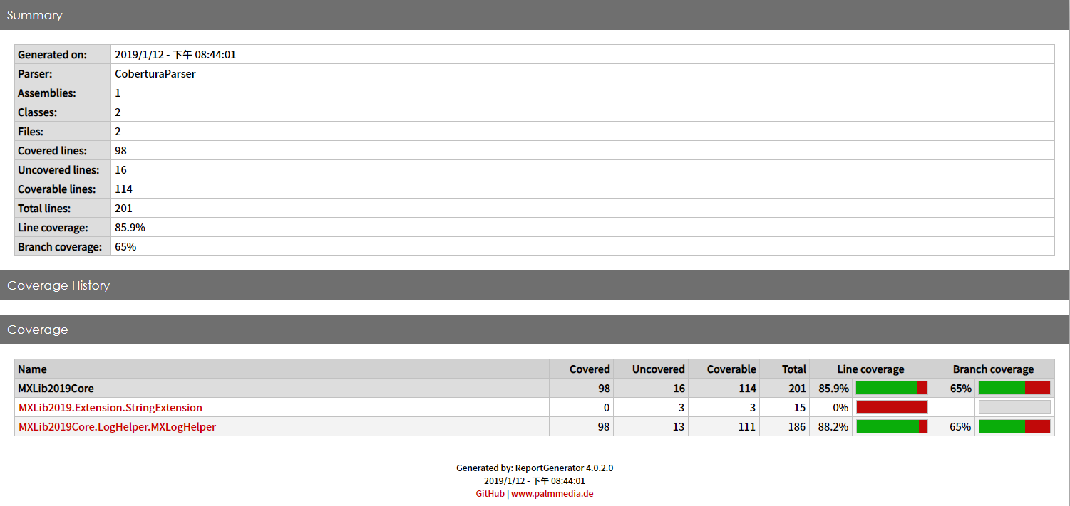
Code Coverage Report

Slide 10
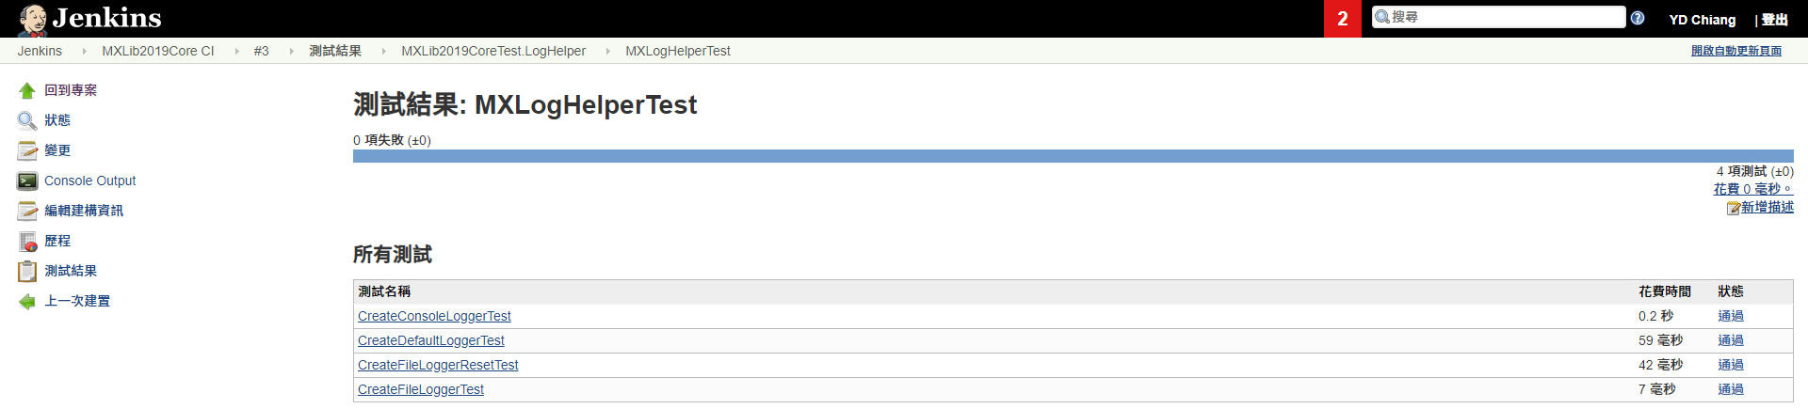
測試結果報告

Slide 11
Plugins
MSBuild Plugin 1.29 This plugin makes it possible to build a Visual Studio project (.proj) and solution files (.sln).
NUnit plugin 0.23 This plugin transforms NUnit test reports so they can be recorded by Jenkins' JUnit features.
HTML Publisher plugin 1.17 This plugin publishes HTML reports.
MSTest 0.23 This plugin converts MSTest TRX test reports into JUnit XML reports so it can be integrated with Hudson's JUnit features.

